Slide 1
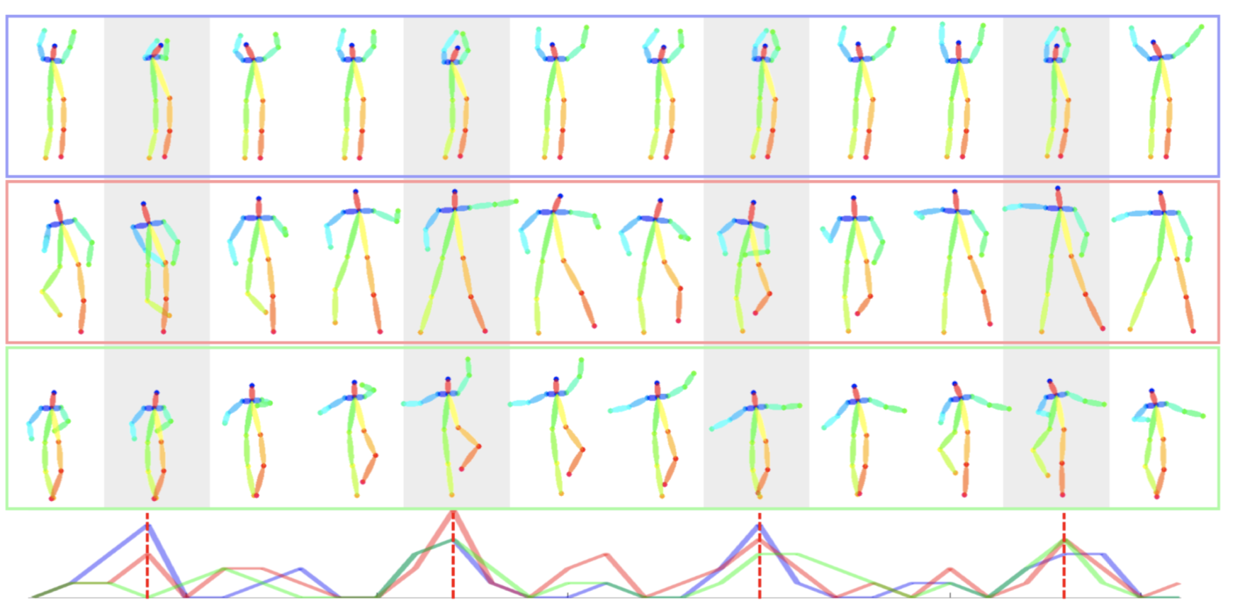
Dancing to Music
Han Yan, Weiyu Du
CIS 565 Final Project Milestone 1

Slide 2
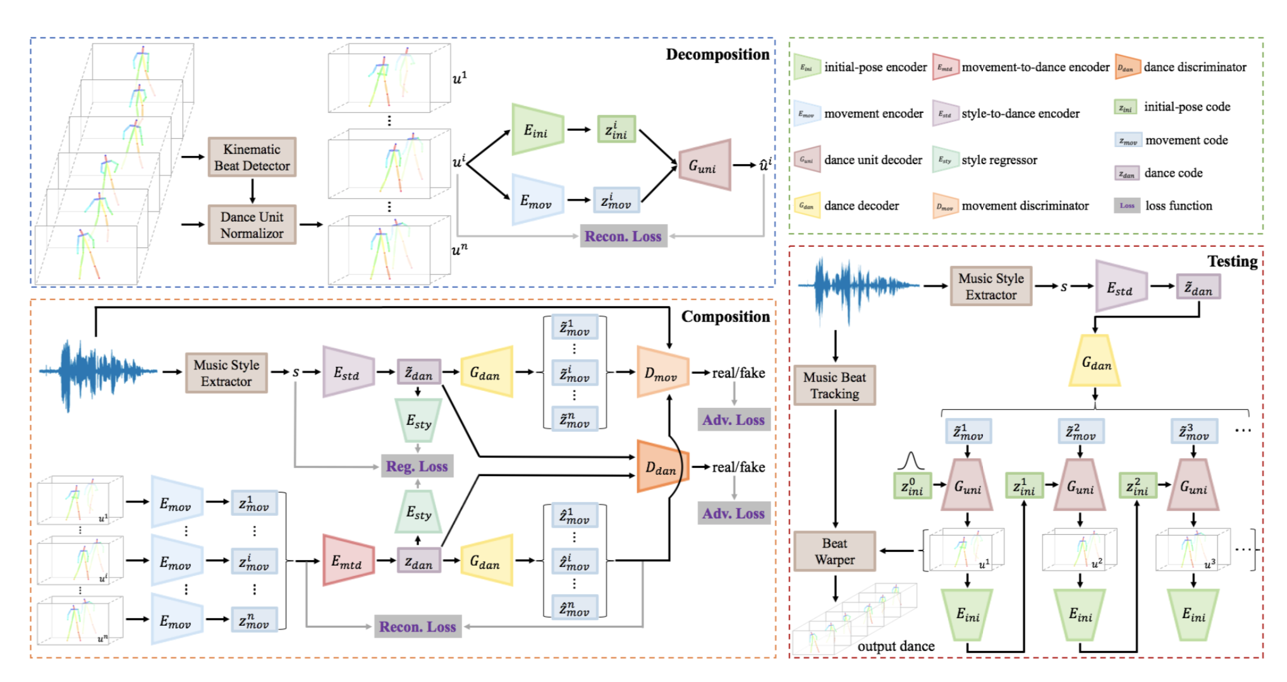
Method

Slide 3
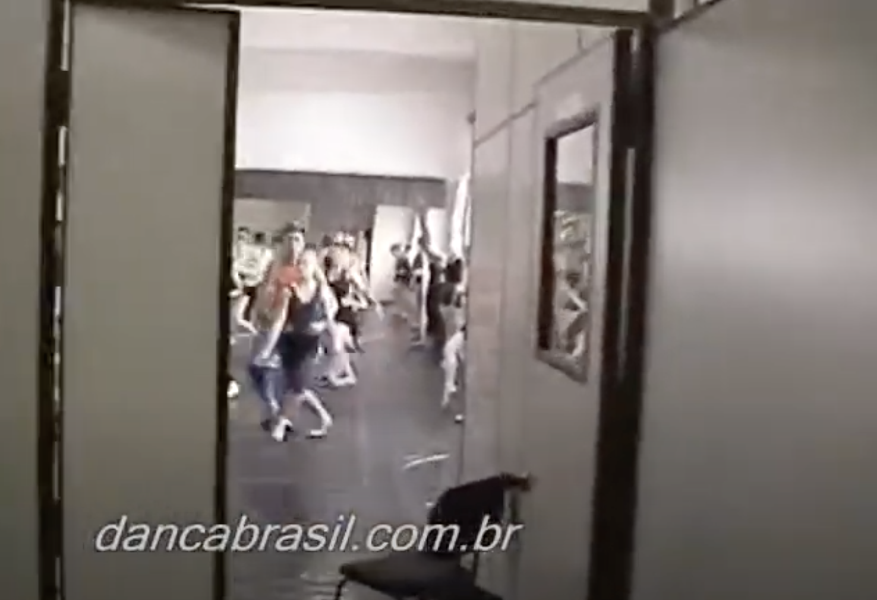
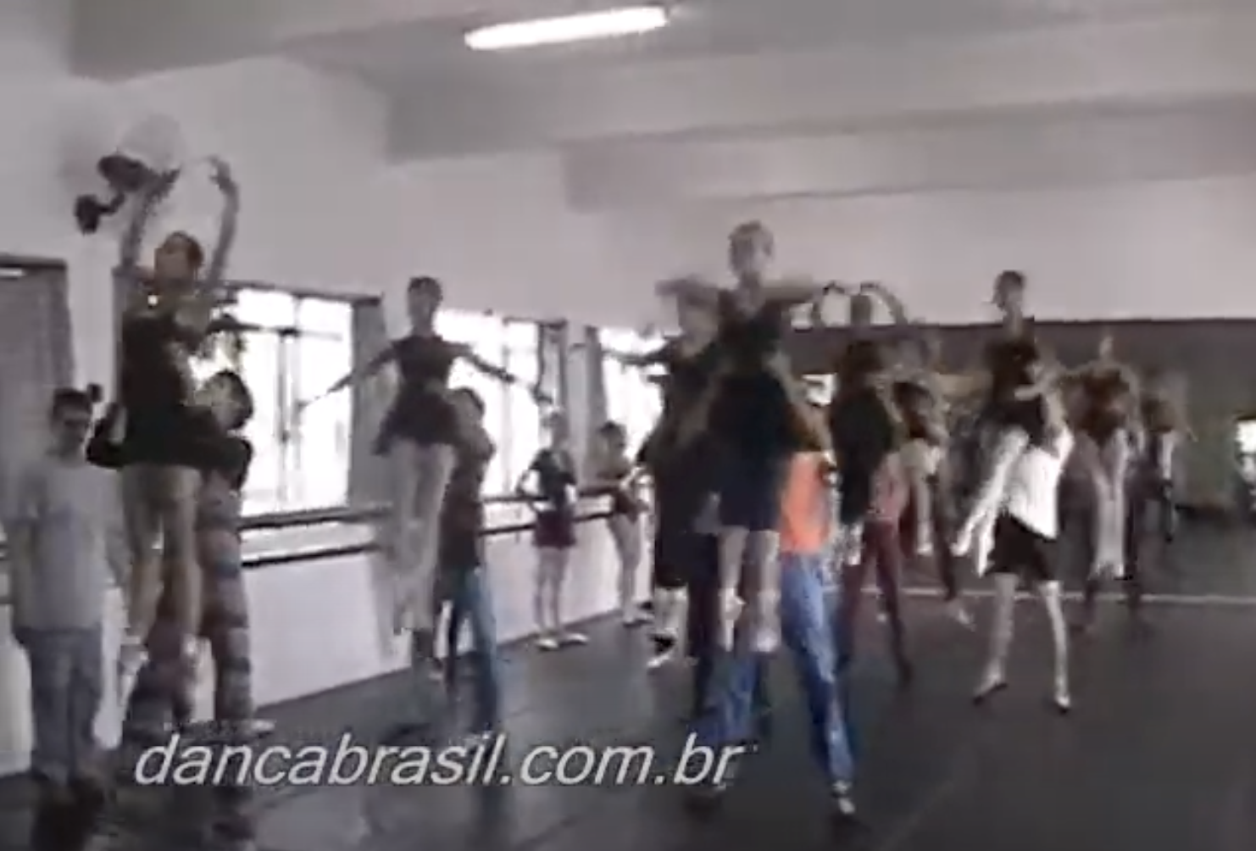
Attempts with 3D Dances
Two publicly available dance datasets
Dataset collected by Lee et al. (Dancing to Music, Neurips 2019)
Dataset collected by Tang et al. (Dance with Melody, ACM 2018)
Neither came with raw videos to extract 3D poses from
YouTube8M Dance category
Diverse video dataset collected from YouTube
Challenges
Group dance: multiple humans
Camera zoom
Uncleaned data: dance practice, background music instead of dance music

Slide 4
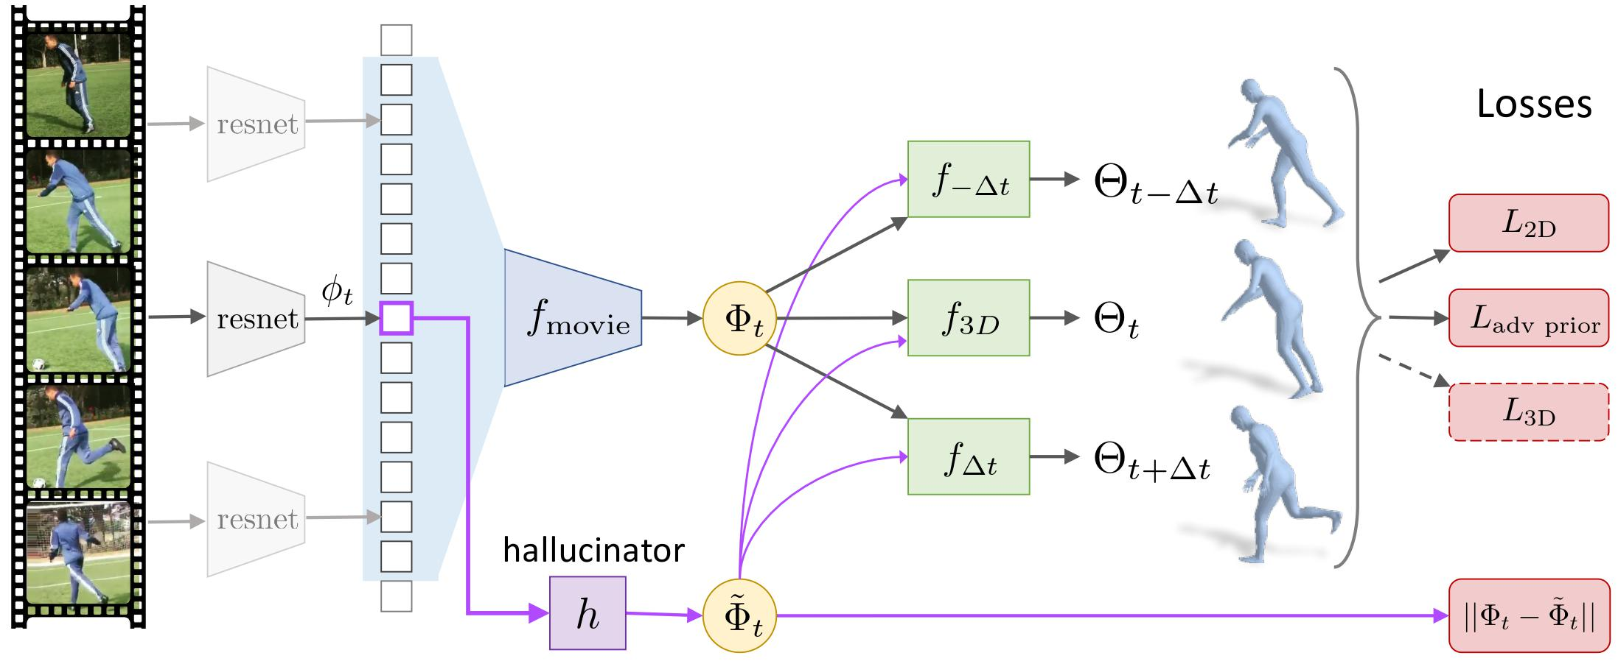
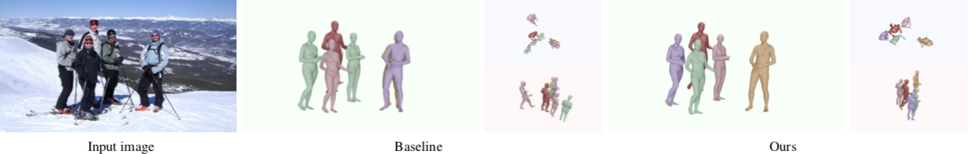
Attempts with 3D Dances
Original method
Extracting dynamics from video
Kanazawa et al. Learning 3D Human Dynamics from Video
Not feasible
New method
Pose estimation from image
Jiang et al. Coherent Reconstruction of Multiple Humans from a Single Image, CVPR 2020

Slide 5
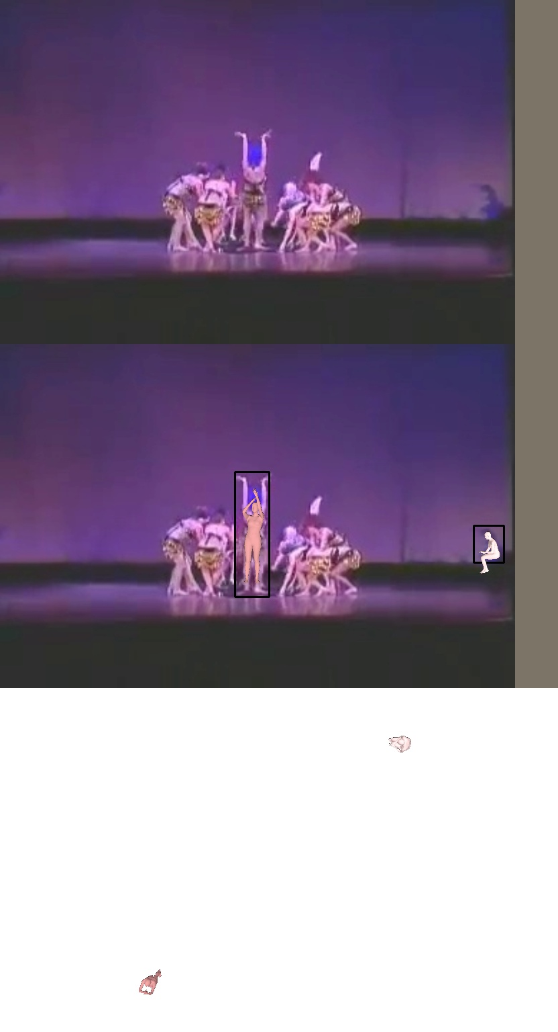
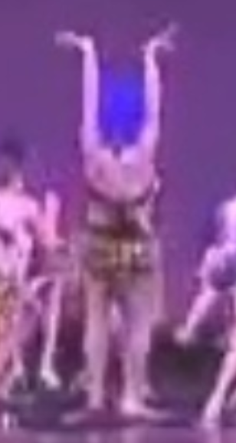
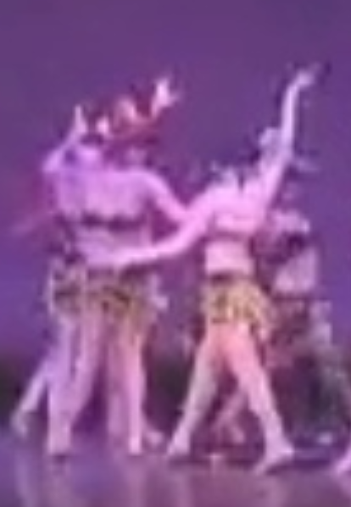
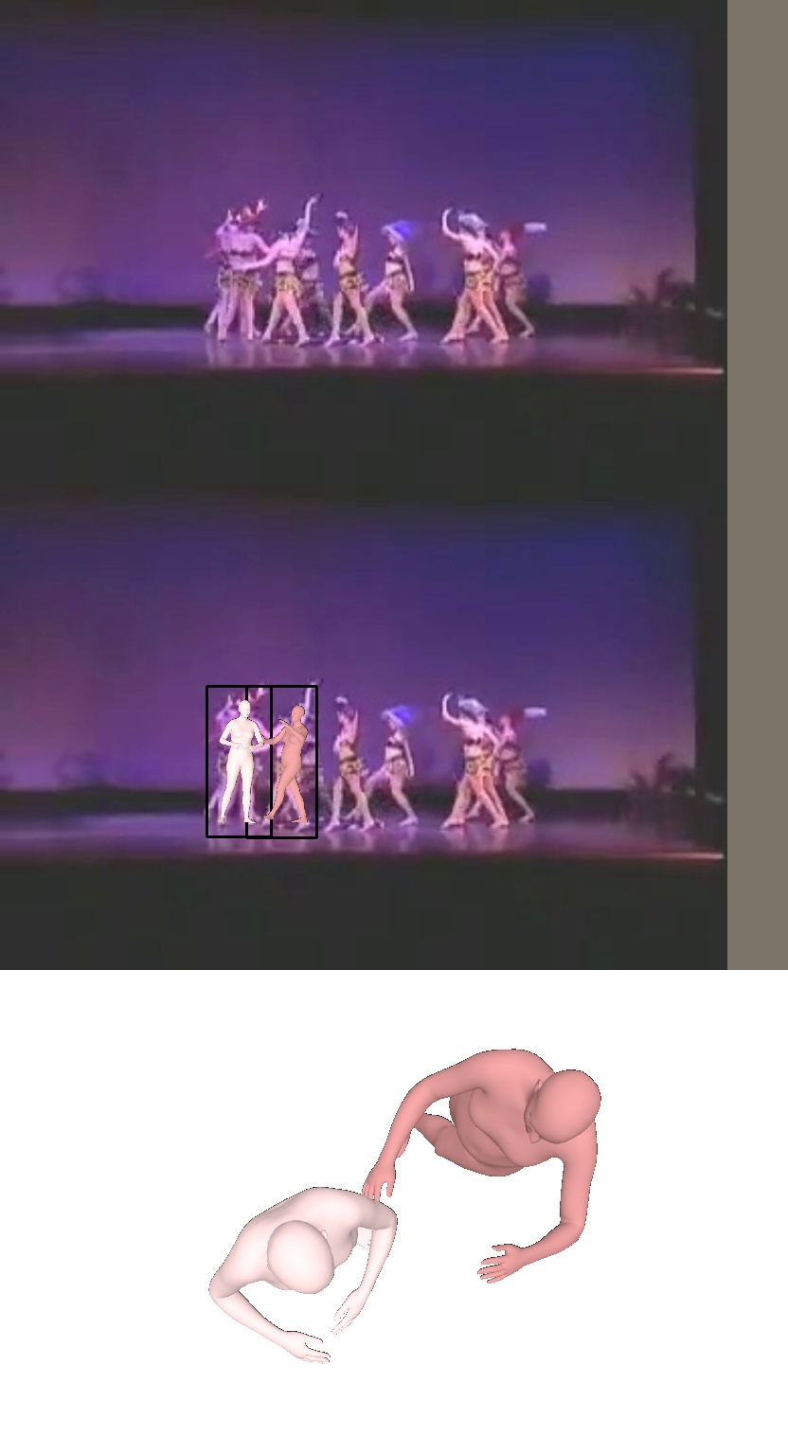
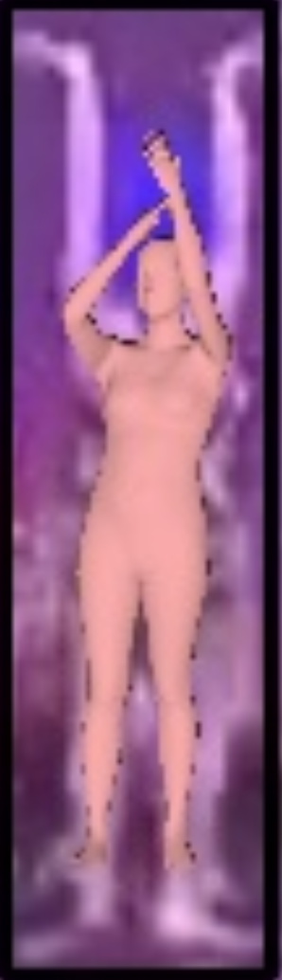
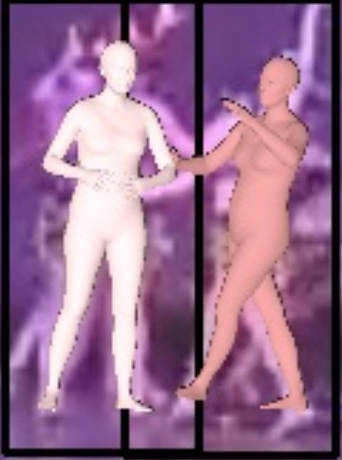

Slide 6
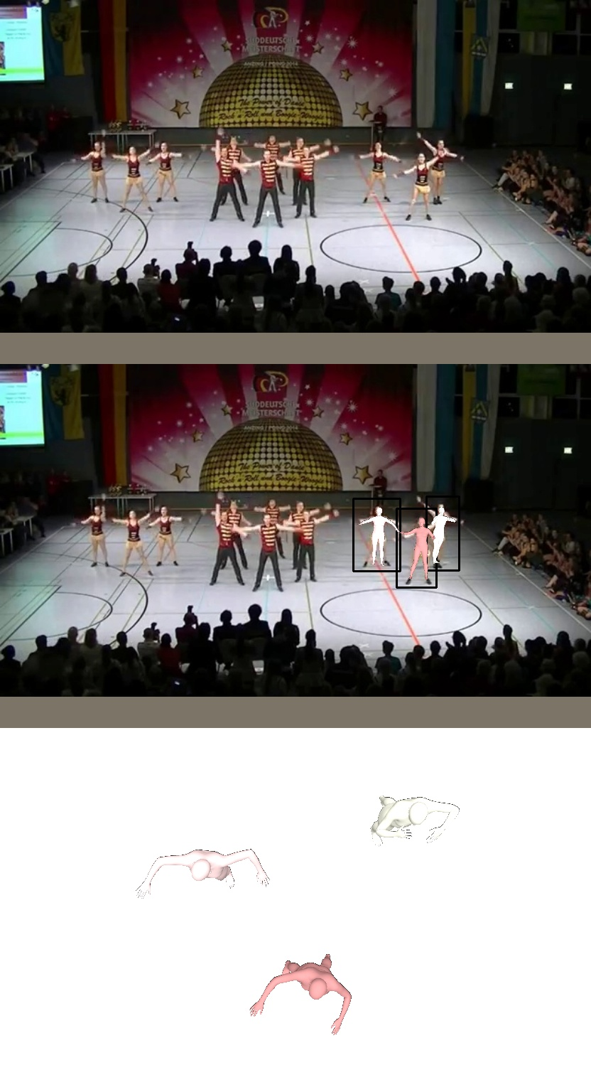
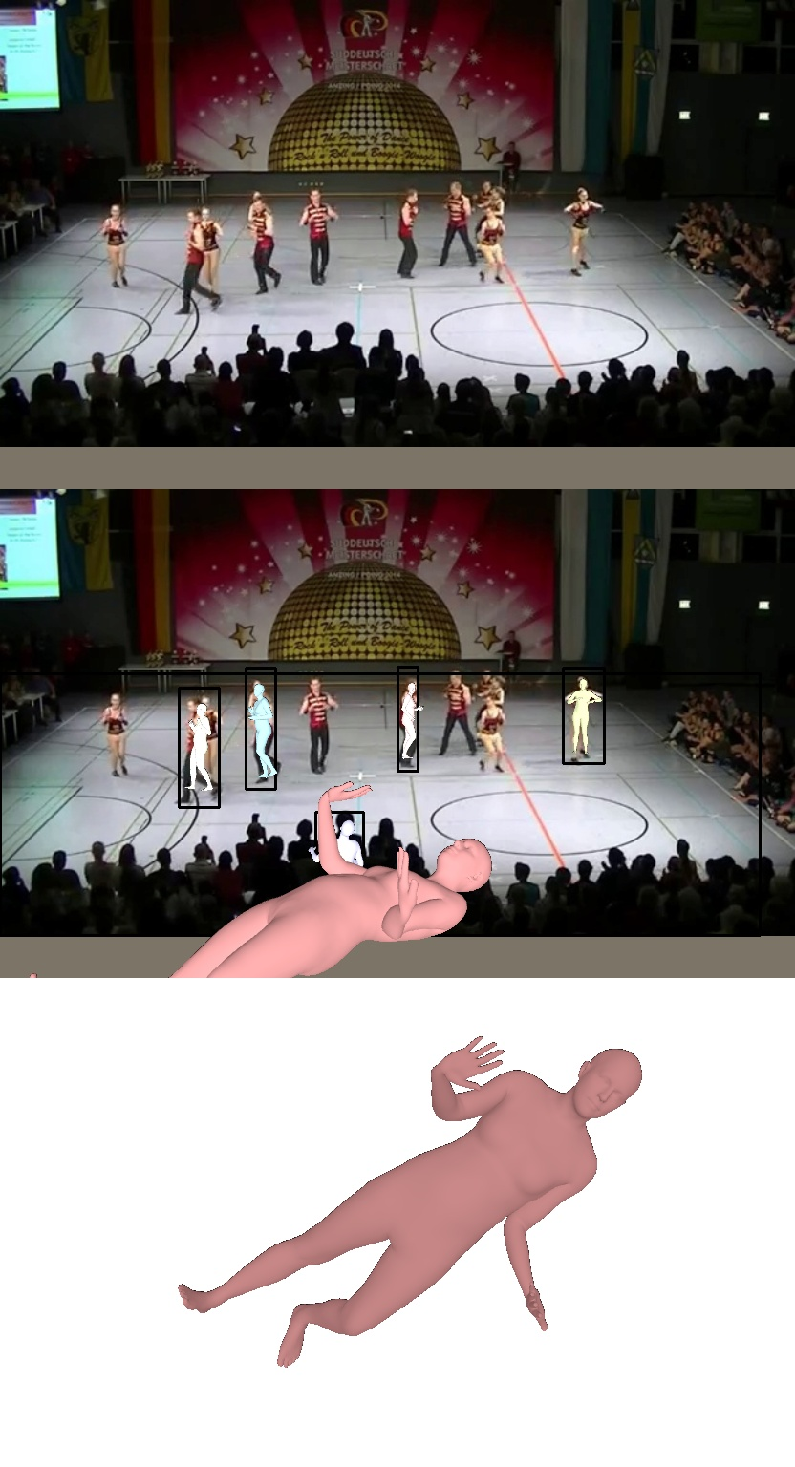
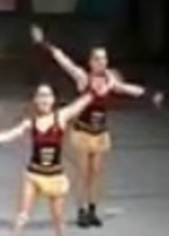
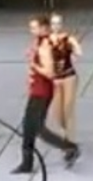
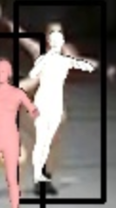
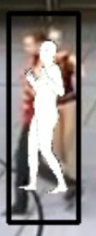

Slide 7
Shifting our attention back to 2D case:)
Based our code on Lee et al. Dancing to Music PyTorch implementation
Data preprocessing
Debugging
Model training & parameter tuning
Logging and visualization via Tensorboard
Support for saving multiple experiments, choosing CUDA card etc.
Notes:
Training: 400 epoch each, 20h each, choose min loss models
Input: music (.wav)
Output: style and beats data (.npy)
Run MFCC on each frame to obtain power spectrum (style)
Compute change of magnitude in each frequency at every t (beats)
To align with dance poses, adjust audio window length to match fps = 15.

Slide 8
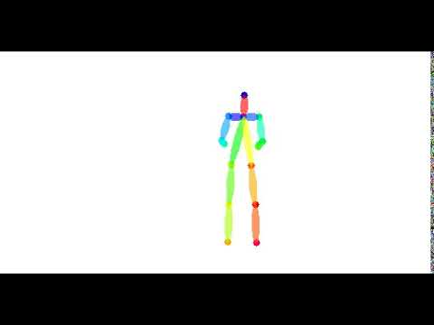
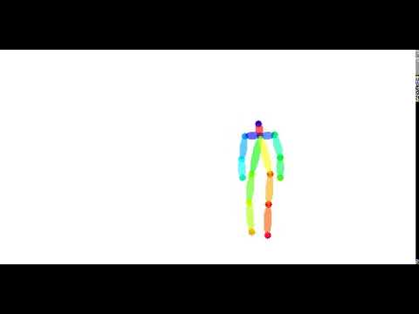
Results and Visualization (Training)
Ballet
Hiphop

Slide 9

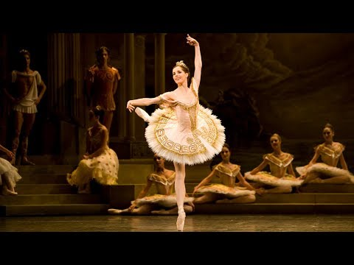
Results and Visualization (Inference)
Music: Sylvia, Act 3 (ballet)

Slide 10
Conclusion
State-of-the-art music to dance generation does not work as well as we are led to believe, even for 2D cases
Current method is good at
It actually dances!
Matching the beats
While it fails at
Understanding the beats (strong & weak beats, end of a melody)
Does not produce well-articulated dance movements
A bug remained to be solved: seems pose generation is longer than audio
Milestone 2: Focus on improving articulation in dance movements

